Slide 1

Introducing: Predicting Laptop Prices Based on Specifications (PredLap)
We're excited to introduce a revolutionary web-based tool that leverages data to predict laptop prices based on specifications.

Slide 2

Problem Statement
1
Varied Pricing
Laptop prices are heavily influenced by specifications, making it challenging for users to find the best value.
2
Difficult Comparisons
Comparing laptop specifications across different models and brands can be overwhelming and time-consuming.
3
Price Changing
Price Changes Frequently as it's hard trying to Predict it Without deep searching

Slide 3

Our Solution
Our website provides a simple and intuitive way to predict laptop prices based on user-defined specifications. Our system analyzes vast amounts of data to estimate the average price of a laptop with the given specifications.
Our Machine Learning Model has been trained on Recent Data that has been taking from Popular websites like Noon , 2B , Vodafone , Aman and Jumia

Slide 4

Key Specifications
Processor
RAM
Brand
Storage
Graphics Card
Screen Size
Storage
Operating System

Slide 5


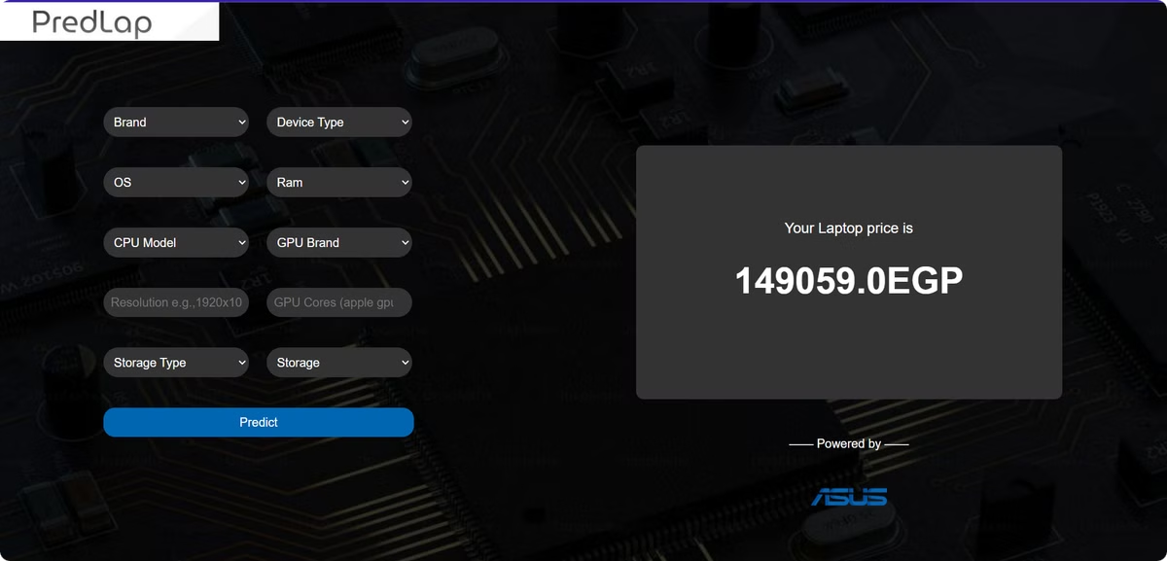


How it Works
Input Specifications
Users enter their desired laptop specifications, such as processor, RAM, storage, and screen size.
Data Analysis
Our advanced algorithms analyze a massive dataset of laptop specifications and prices to identify patterns and trends.
Price Prediction
Based on the analyzed data, the website generates an estimated average price for a laptop with the given specifications.

Slide 6
Why Choose PredLap?
Free
Reliable Predictions
PredLap is completely free to use, with no hidden fees or subscriptions.
Our sophisticated algorithms and comprehensive data ensure accurate price estimates.
User-Friendly Interface
Accessibility
PredLap is designed with simplicity and ease of use in mind.
PredLap is accessible anytime, anywhere, on any device.

Slide 7
Pricing
Free Access
Powerful Tool
Free Plan Features
Our website offers a free access plan for everyone. This plan comes with no limits, so users can enjoy all of our features without any restrictions.
We believe that everyone should have access to our powerful tool, which is why we've made the free plan so comprehensive.
Predict laptop prices based on desired specifications.
Explore a wide range of specifications and price estimations.
Utilize our advanced algorithms to find the best deals on laptops.

Slide 8

Conclusion
Our website provides a simple, yet powerful, solution for quickly estimating laptop prices. We empower users to make informed purchasing decisions by providing them with a clear understanding of the market value of their desired laptop configurations.

